Slide 1
Boost Surprising Discoveries for Online Health Information
Group 7
Hemanth Kumar Koraboina
Sai Kiran Mankena
Anvesh Kottapelli
Kavya Mandli

Slide 2
Type of Surprise
Personalized Surprise :
Topic Modelling
Categorization of Data to find Surprise
SVM Model
Rareity of words
Sum of the less frequency Words
Document Term Matrix with only the rare words has been constructed

Slide 3
Techniques Implemented
We’ve used 2 different techniques to implement this.
Latent Dirichlet Allocation(Exploring Data by Topic Modeling)
Support Vector Machine(Machine Learning)

Slide 4
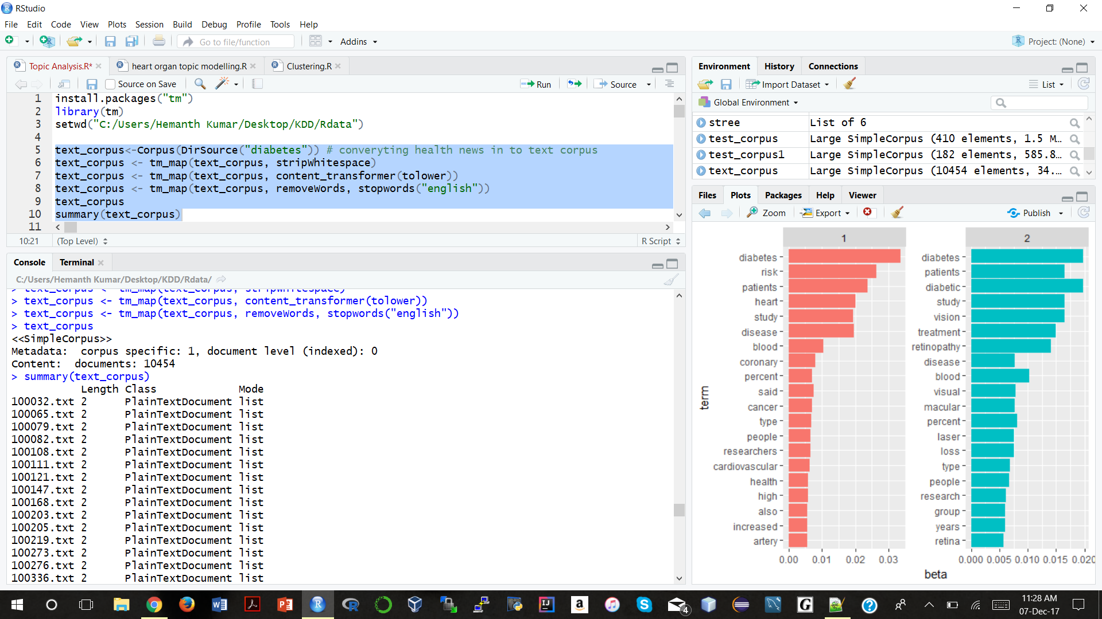
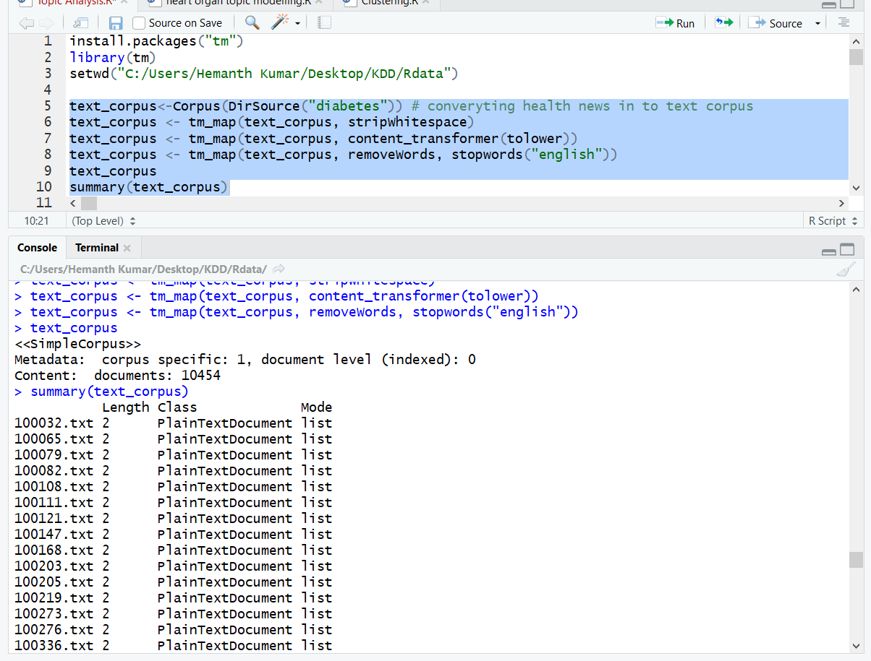
Preprocessing
Transformations Applied:
Remove White Spaces
Converting to lower case
Removing English stop- words

Slide 5
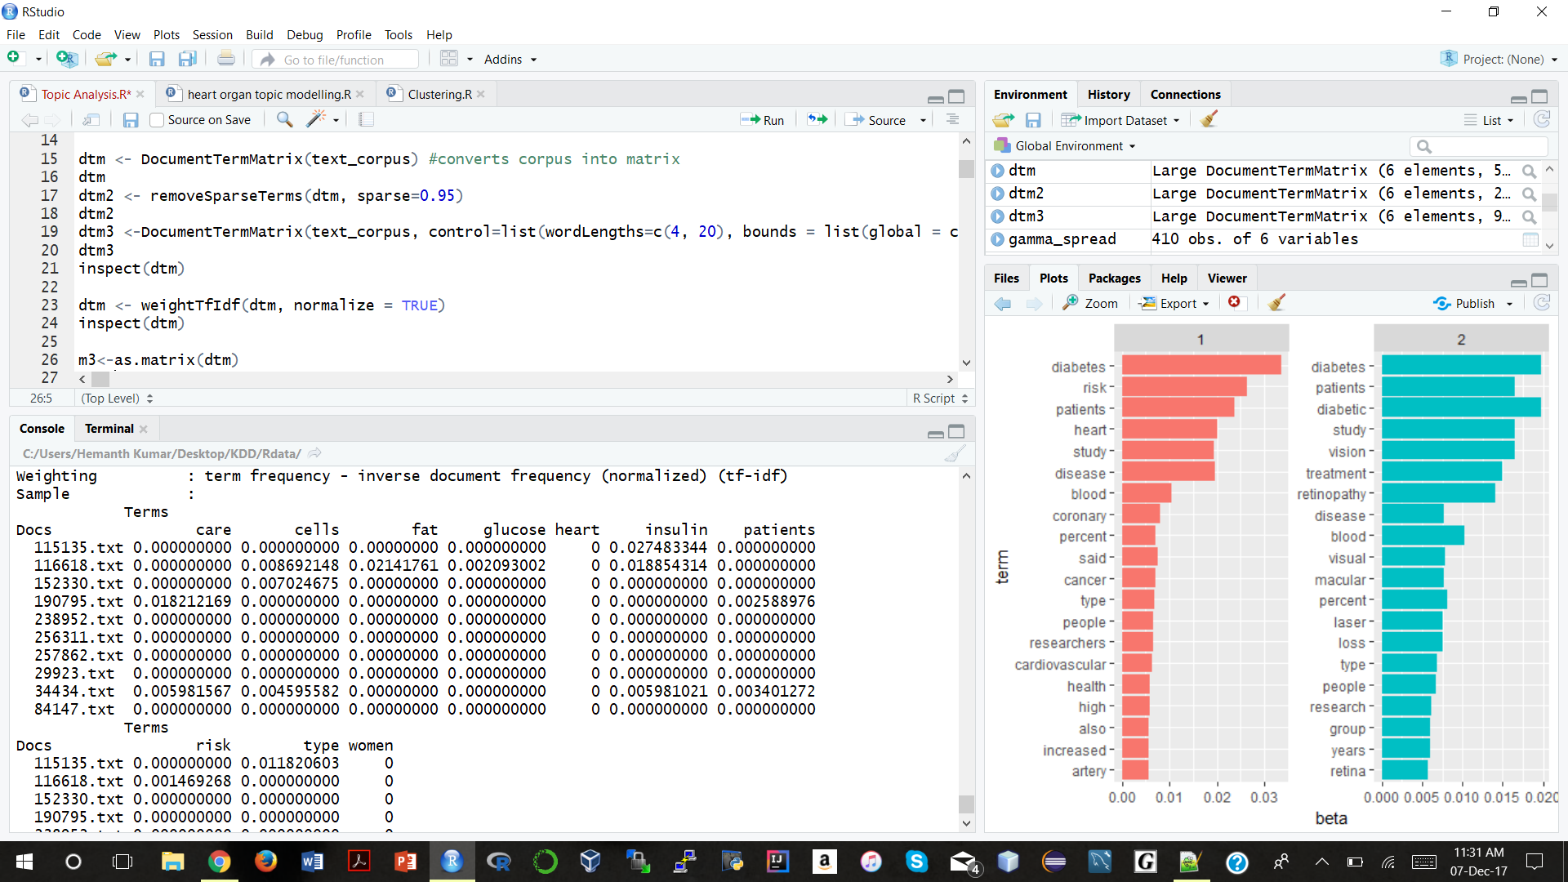
TF-IDF
TF-IDF: Term Frequency-Inverse Document Frequency: The TF-IDF weight is a weight often used in information retrieval and text mining
This weight is a statistical measure used to evaluate how important a word is to a document in a collection or corpus

Slide 6
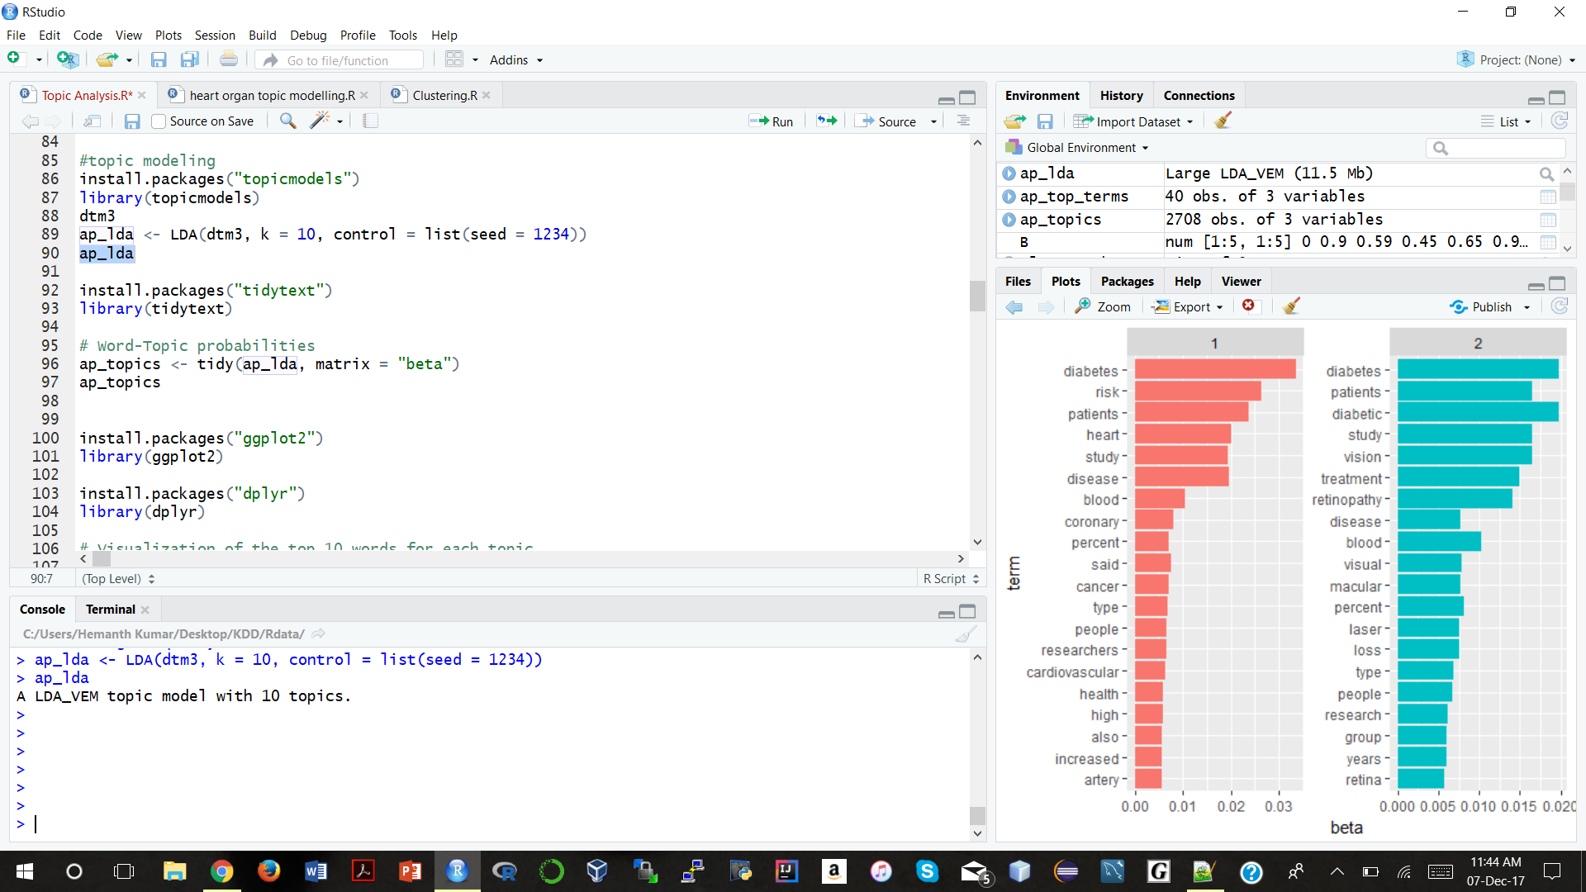
LDA
Applied Latent Dirichlet Allocation topic Modeling on Data set.
We have chosen 10 topics.

Slide 7
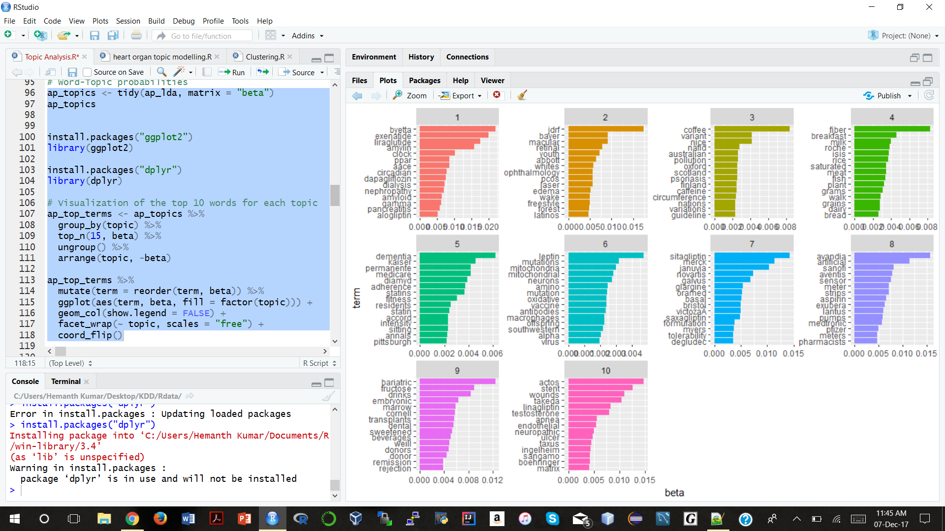
Topic Modelling Visualization

Slide 8
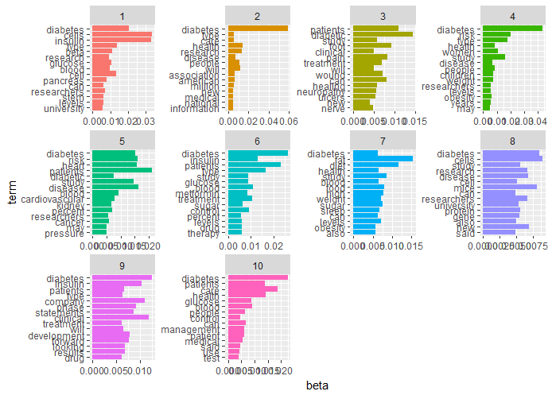
Top 15 frequent words in the topics

Slide 9
Drilling Down on Topic 5

Slide 10
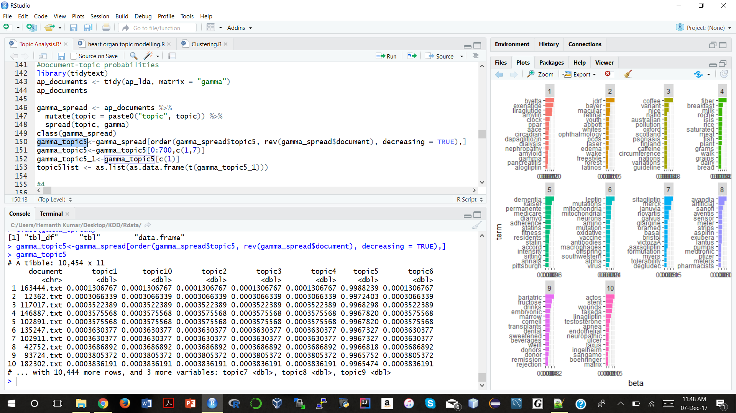
Topic Modelling -2

Slide 11
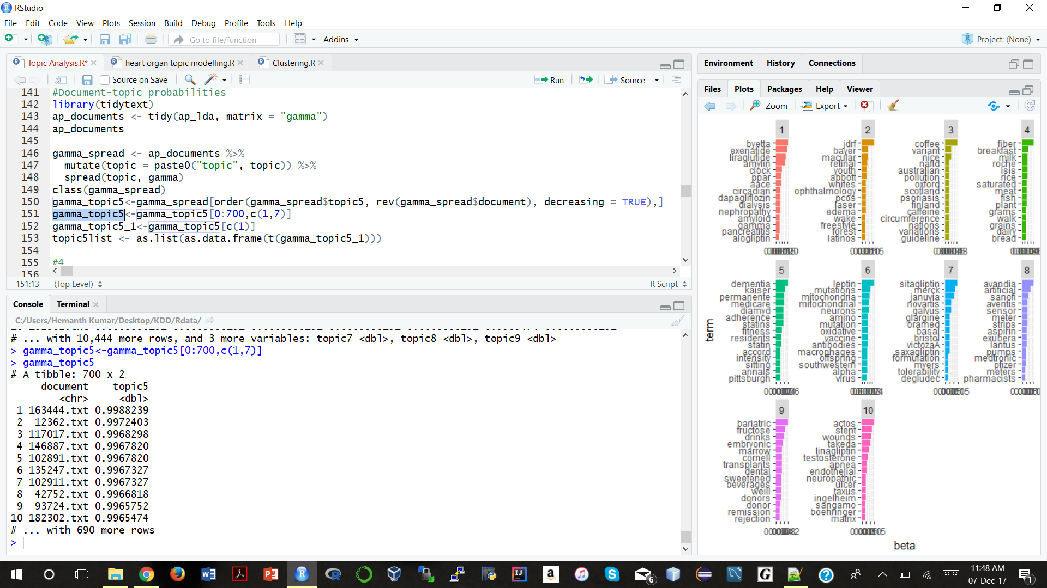
Topic Modelling on Topic 5

Slide 12
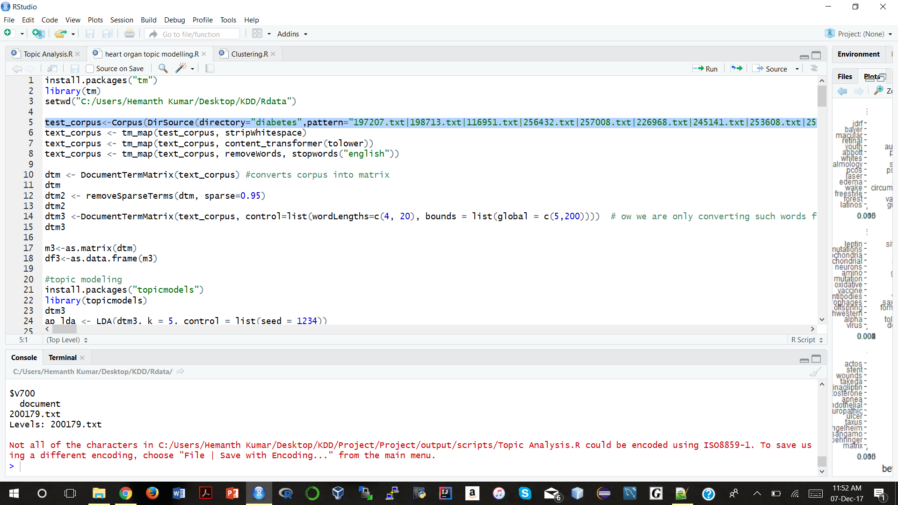
Topic Modelling on Topic 5

Slide 13
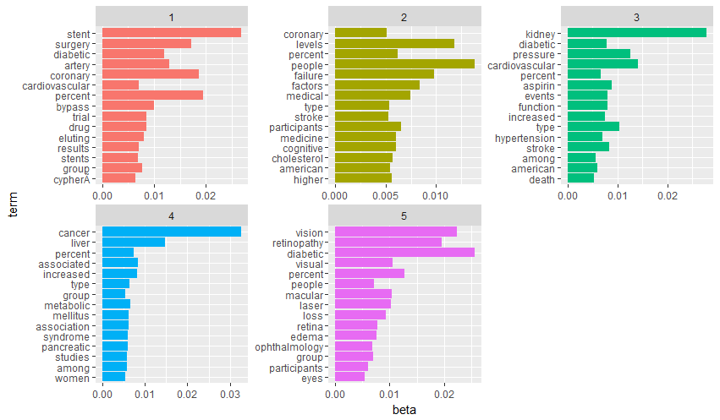
Topic Modelling on Topic 5

Slide 14
Topic Modelling on Topic 1 of 5

Slide 15
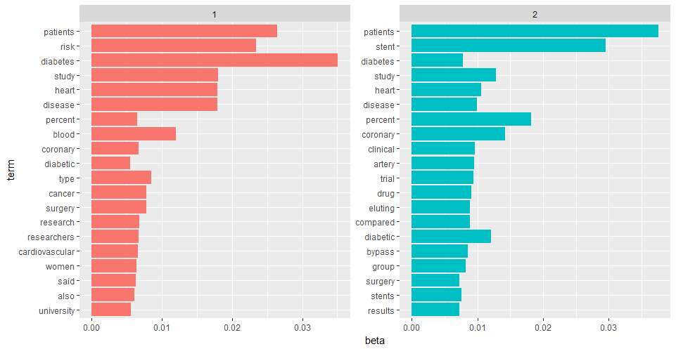
Topic Modelling on Topic 1 of 5

Slide 16
Topic Modelling on Topic 5 of 5

Slide 17
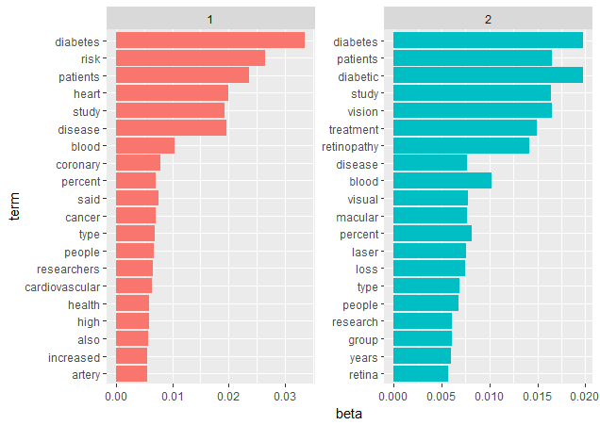
Topic Modelling on Topic 5 of 5

Slide 18
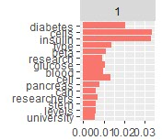
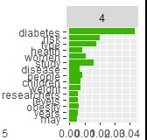
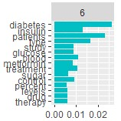
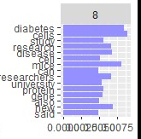
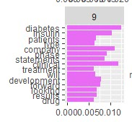
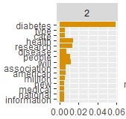
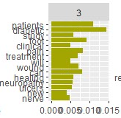
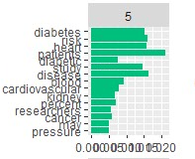
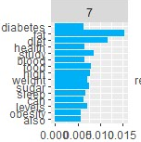
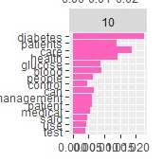
Diabetes

Slide 19
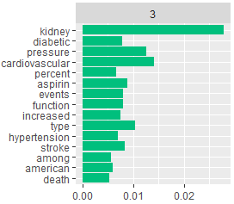
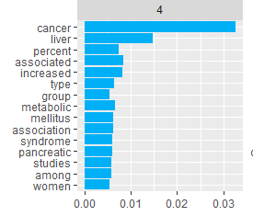
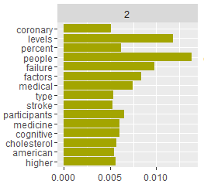
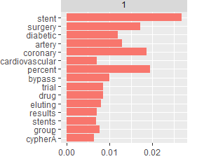
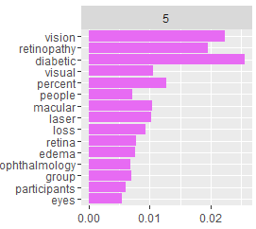
TOPIC 5

Slide 20
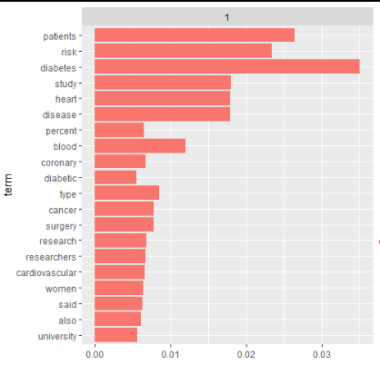
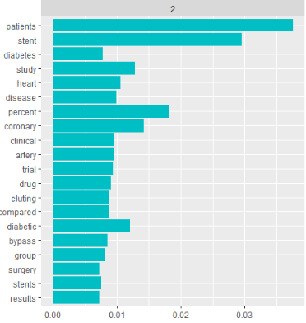
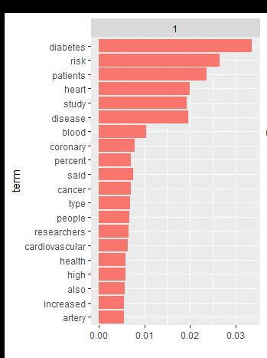
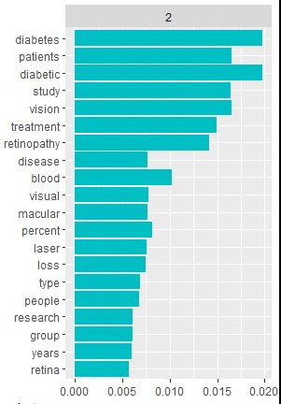

Slide 21
Support Vector Machine(Machine Learning)
Supervised Machine learning model which can be used for both classification and regression
SVM models works better when predicting data with dimensions
Preferred this model since our document term matrix has about 4000 columns( 4000 rare words)
Produces better accuracy while prediction

Slide 22
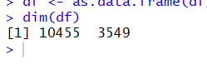
Document Term Matrix
Word length considered to be picked : 5 to 20
Boundary of documents considered for picking rare words : 20 to 60 (that occur only in 5%)
dtm <- DocumentTermMatrix(text_corpus, control=list(wordLengths=c(5, 20), bounds = list(global = c(20,60))))

Slide 23
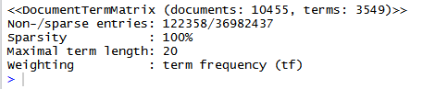
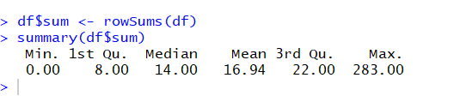
Document Term Matrix
Summary of sum of all rare words in a particular document:

Slide 24
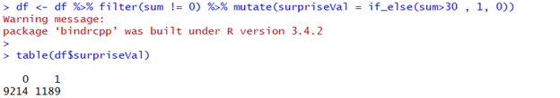
Creating the target variable
By the personalised surprise we used, we got surprise documents to non-surprise documents almost in the ratio of
1: 9

Slide 25
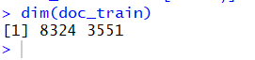
Training using SVM model
Divided the data into train and test data
80% of the data was taken for training
Dimensions of both the train data and test data
Our test data has 2131 documents to test on.

Slide 26
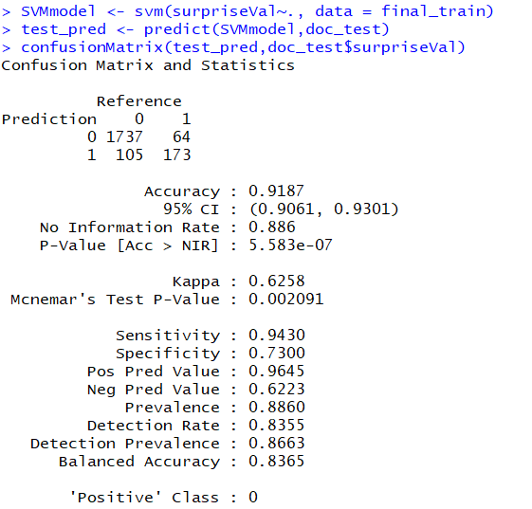
Results
Using SVM model to train the data set and testing with Test Data.

Slide 27
Conclusions
Similar to outlier detection
The biggest challenge was the statistics part in order to define our own personalised surprise
Application:
This surprise document detection along with topic modelling can be used to populate feed in websites depending on what the users prefer
Whether they’re looking for similar articles from past.
Or for something new ( Surprise articles )

